Slide 1
Governor’s Advisory Board for Telecommunications Relay
October 27, 2022

Slide 2

Director’s Report
David Bahar
Director
David.Bahar@Maryland.gov | 240-319-9199 (SMS)

Slide 3


Questions?

Slide 4
Finance Manager’s Report
Leslie Hannibal
TAM Finance Manager
Leslie.Hannibal2@Maryland.gov | 443-767-6971 (office)

Slide 5


Beginning Balance
Finance Manager Report

Slide 6
Expenditures
Finance Manager Report

Slide 7
Revenue
Finance Manager Report

Slide 8
Ending Balance
Finance Manager Report

Slide 9
Questions?

Slide 10

Manager’s Report
Travis Dougherty
Maryland Relay Manager
Travis.Dougherty@Maryland.gov | 202-753-9119 (VP)

Slide 11
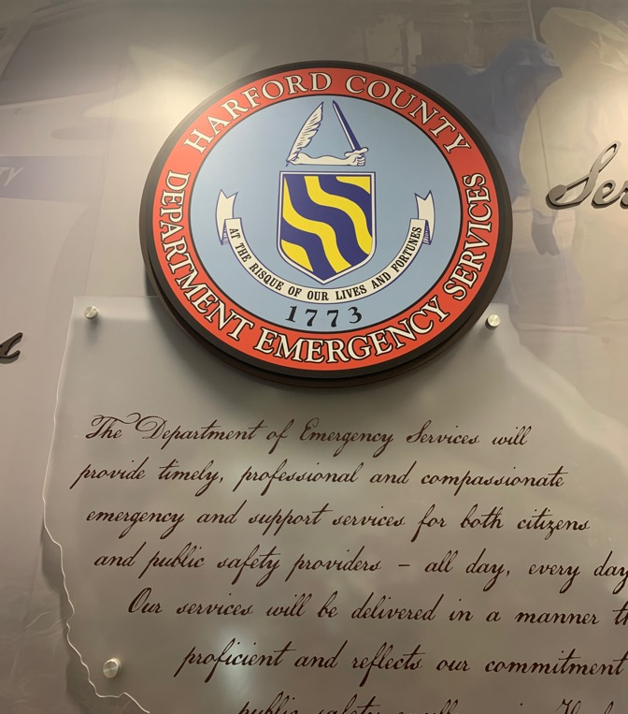
PSAP Visit

Slide 12

General Updates

Slide 13
General Updates
Broadband Diligence
CTS Taskforce Update
Recertification

Slide 14
RCC Guidelines
Maryland Relay Manager Report

Slide 15
Questions?

Slide 16

MAT Manager’s Report
Kevin Steffy
MAT Manager
Kevin.Steffy@Maryland.gov | 443-852-6717 (SMS)

Slide 17


General Updates
From July to September 2022, MAT has received 87 new applications and distributed a total of 120 pieces of telecommunications equipment.
In the previous quarterly report, we received 49 new applications and distributed a total of 82 pieces of telecommunications equipment.
87
49
new applications
new applications
pieces of telecommunications equipment
120
pieces of
telecommunications
equipment
82
MAT Manager Report

Slide 18
Evaluation Centers
The Arc in Harford County
Maryland Deaf Community Center (MDCC)
DILA
In Salisbury
MAT Manager Report

Slide 19
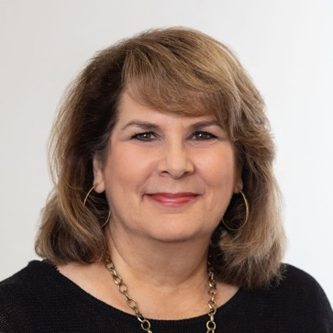
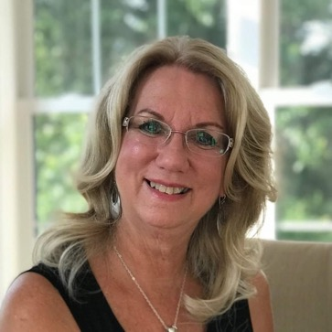
Recognition
I would like to recognize two of our evaluators for their hard work.
Betsy Hein
Brenda Bush
MAT Manager Report

Slide 20
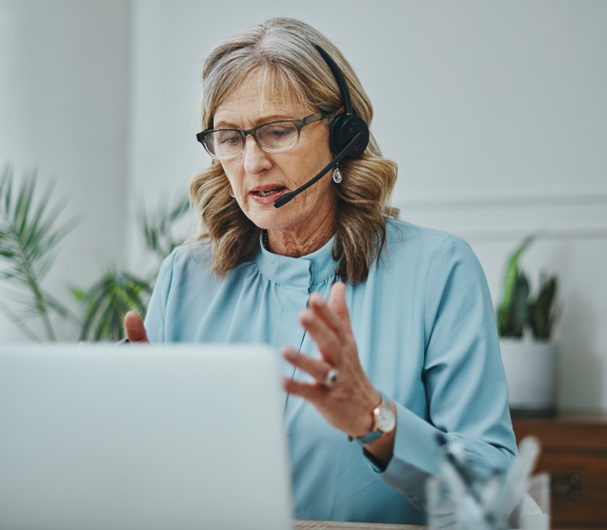
Communication Facilitator (CF)
From July to September 2022, the CF service has provided 60 services. In the previous quarterly report, we provided 35 services.
The total for FY 2022 (December 2021–June 2022) is 63 services.
For the next quarter (October–December 2022), we have already scheduled 55 services.
MAT Manager Report

Slide 21
Communication Facilitator (CF)
As of today, we have 12 DeafBlind individuals.
Jane and I did the outreach.
We will provide CF and PT training at the Eastern Shore soon.
We will also provide CF re-training for those facilitators who need more training on their skills.
MAT Manager Report

Slide 22
Questions?

Slide 23
Public Relations & Outreach Report
Donna Broadway-Callaman
Community Outreach Manager
DonnaT.Broadway-Callaman@Maryland.gov | 443-240-9969

Slide 24
What’s New With Maryland Relay?
This summer has been very busy for Maryland Relay and the MAT team. We have participated in events such as:
  Maryland Association of Counties
  Maryland Chiefs and Sheriffs' Association Professional Development Training Seminar & Exhibitor Show in September
  Maryland School of the Deaf 50th Anniversary sponsorship
  Deaf Surf Day
  Several TV segments
  And a lot of 911 and Relay Partner trainings
Public Relations & Outreach Report

Slide 25
What’s New With Maryland Relay?
We are also continuing to prepare for a few major upcoming conferences:
  NAACP health fair
  Mid-Atlantic ADA conference, held in Alexandria, Virginia
  Maryland Rural Health Association
  National Federation of the Blind conference in Maryland
  M-enabling Summit
  Maryland Rehab Conference
  and the World of Possibilities Expo
Public Relations & Outreach Report

Slide 26

What’s New With Maryland Relay?
Travis and I are working together to put together a series of townhall events. They will be held at various times, in various locations throughout the state of Maryland. We will share more information, once everything is confirmed.
We are still working closely with the teams at MDoD, namely Yesheva Kelly, and DoIT, to migrate from our old platform onto the MDoD platform. This is intended as a temporary, holdover website until we get our permanent website. The date of that is still TBD.
Public Relations & Outreach Report

Slide 27
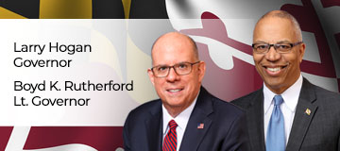
What’s New With Maryland Relay?
It is election year, and we are preparing for the gubernatorial transition which means:
  Gathering information about TAM, Maryland Relay, and MAT and what we’ve accomplished during Governor Hogan’s term
  Figuring out when and how to update the collateral once the new governor is inaugurated/implements new guidelines for logos, collateral, and other state materials
Public Relations & Outreach Report

Slide 28
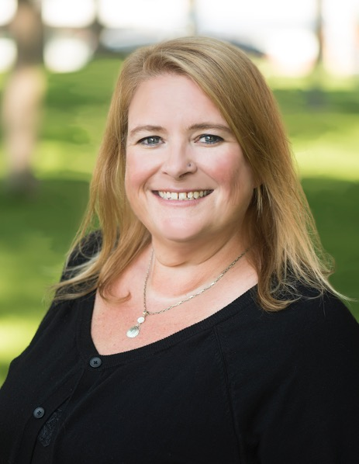
What’s New With Maryland Relay?
Jenny Pearson’s last day with Maryland Relay was October 15.
I wanted to publicly thank Jenny, who was with us for five years, for her hard work and dedication and we wish her the best in her future endeavors.
Public Relations & Outreach Report

Slide 29




What’s New With Maryland Relay?
We have been using our social media pages to increase our visibility.
We have created a TikTok and are working on content that promotes our programs and various phones and equipment.
We have used our Facebook to promote awareness days and initiatives such as Disability Employment Awareness Month, World Stroke Day, International Week of Deaf People.
Outreach has a designated email tam.outreach@maryland.gov. We will use this for RSVP’s and special outreach projects.
MD relay: does someone have the TikTok name?
@MDRelay711
@_________
facebook.com/
MarylandRelay711
@MDRelay711
Public Relations & Outreach Report

Slide 30

Continued Outreach Efforts
Advertising
Webinars
Mailings
Virtual/Hybrid Events
Networking/Making New Contacts
Field Visits
Television ads/
paid segments
Hamilton Relay Report
January 14, 2022

Slide 31

Hamilton Relay
Updates

Slide 32
Maryland TRS
Percent Answered in 10 seconds
Hamilton Relay Report

Slide 33
Maryland Captioned Telephone
Percent Answered in 10 seconds
Hamilton Relay Report

Slide 34
Maryland TRS
Session & Conversation Minutes
Hamilton Relay Report

Slide 35
Maryland Captioned Telephone
Session & Conversation Minutes
Hamilton Relay Report

Slide 36
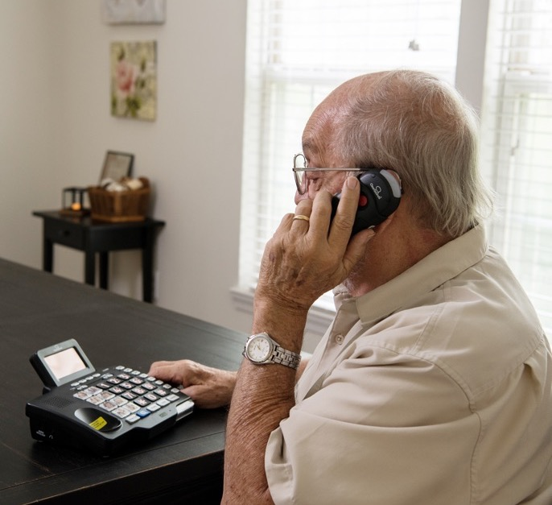
Maryland TRS
Customer Care Contacts
 | Dec | Jan | Feb
Technical | 0 | 0 | 0
General Information | 3 | 8 | 9
Equipment | 4 | 2 | 5
Customer Profile | 2 | 4 | 3
Outreach Complaints | 0 | 0 | 1
Operations Complaints | 0 | 0 | 0
External Complaints | 0 | 0 | 0
Wrong Number/Hang Up | 56 | 64 | 38
Compliments/Commendations | 0 | 1 | 0
Malicious Caller | 0 | 0 | 0
Hamilton Relay Report

Slide 37
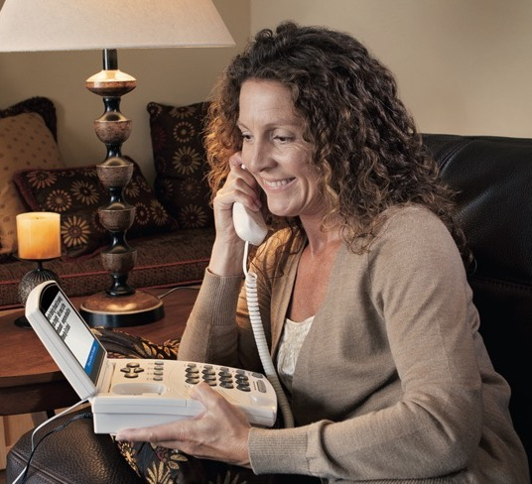
Maryland Captioned Telephone
Customer Care Contacts
 | Dec | Jan | Feb
Service | 0 | 0 | 0
Technical | 0 | 0 | 0
Product | 0 | 0 | 0
Billing | 0 | 0 | 0
Setup | 2 | 0 | 0
Info/Referral/Ed | 0 | 0 | 0
Other | 0 | 0 | 0
Hamilton Relay Report

Slide 38
Outreach Statistics
90 Presentations/
webinars
21 Exhibits
11 Networking
31 Meetings
(includes 3 one-on-one installs for MAT clients)
Hamilton Relay Report

Slide 39
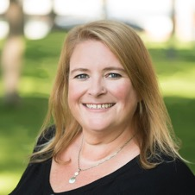
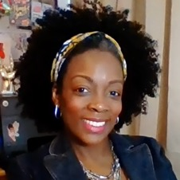

Outreach Highlights
Jenny continued her Minor League Baseball Outreach campaign and exhibited with the Frederick Keys during “Deaf Awareness Night,” the Southern Maryland Blue Crabs, and the Bowie Baysox. This was such a great way to connect with our clients in a family friendly environment.
In order to offer continued support to the MAT team with captioned phone installations, Tarita had the pleasure of going to a MAT client’s home to offer assistance.
Rebecca is working diligently to train PSAPs and has managed to train ALL employees in Allegany, Talbot, Caroline, Carroll, and Calvert counties. That is over 80 people in this quarter alone – WOW!
Hamilton Relay Report

Slide 40

Upcoming Events
November 11, 2022 is Veteran’s Day and the outreach team is taking this time to support Veterans here in Maryland by attending a variety of Veteran focused events in several counties. We hope to see YOU in the community!
October 27, 2022
Hamilton Relay Report

Slide 41

Partnership Shoutouts
Rebecca Miller and David Bahar, gave an amazing
presentation during the National Emergency Number
Association (NENA) Annual Conference on the
ever-developing Real Time Text (RTT) service.
The outreach team appreciates all opportunities to partner with members of the GABTR board as well as the TAM team and wants to remind you that they would love to see you all during the months between meetings.
Hamilton Relay Report

Slide 42
Scholarship Opportunity
Believe it or not, it’s almost time to start searching for a scholarship recipient!
Hamilton Relay offers a scholarship to graduating high school seniors. There’s no time like the present to start thinking about who would be a great applicant.
For more information, please reach out to Tarita at tarita.turner@hamiltonrelay.com or contact her by phone at 240-920-9594.
Hamilton Relay Report

Slide 43

We’d love to see you!
We’d love to see you at some of the upcoming events we will be attending.
Please reach out to the outreach team if you would like us to attend an event that’s important to your community. It would be out pleasure to come out and share resources.
Tarita Turner
MARYLAND RELAY OUTREACH COORDINATOR
Tarita.Turner@HamiltonRelay.com
Rebecca Miller
MARYLAND RTT OUTREACH COORDINATOR
Rebecca.Miller@HamiltonRelay.com
We would love to partner with you!

Slide 44
Questions?

Slide 45
Thank you!
October 27, 2022

